Slide 1
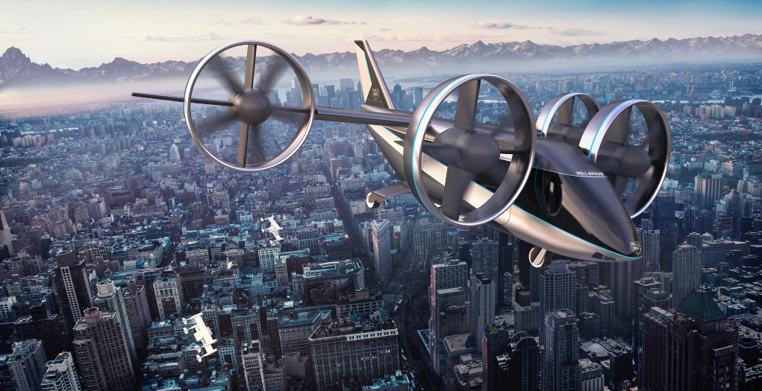
e-VTOL Flying Testbed
Sam Drury
03/12/2020
Supervisor:
Dr Sam Grimshaw
https://www.bellflight.com/products/bell-nexus
Whittle Laboratory

Slide 2
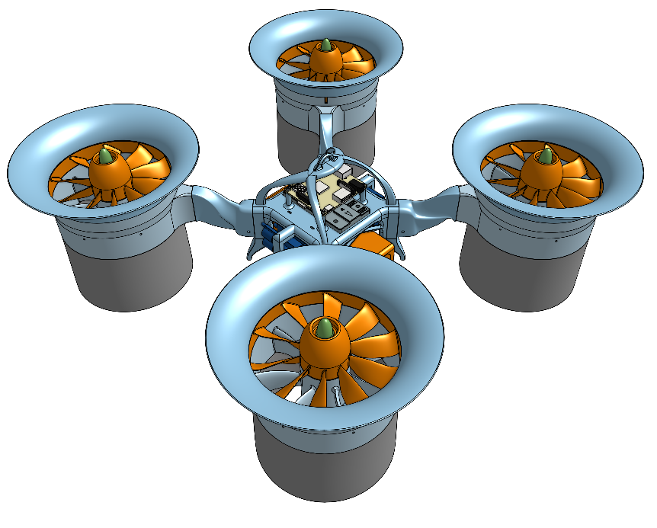
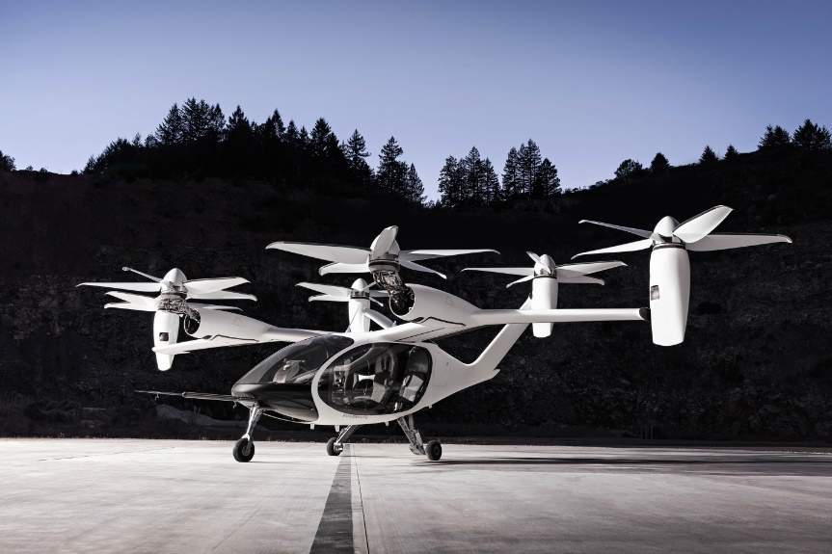
Benefits of Ducted Fans vs Propellors
Ducted Fans can improve hovering performance compared to propellors while being safer and quieter
Notes:
Electric Vertical Take off+landing veh seen as one of the Great emerging technologies of the time
Market size expected to quadruple by 2025
https://www.marketresearchfuture.com/reports/evtol-aircraft-market-7952
High speed commuting, traffic-free
Quieter and cheaper than heli
Zero emission local electric power
Scope to cost same/mile as other ride sharing platforms
Even greater benefits can be envisaged using DUCTED FANS

Slide 3
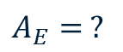
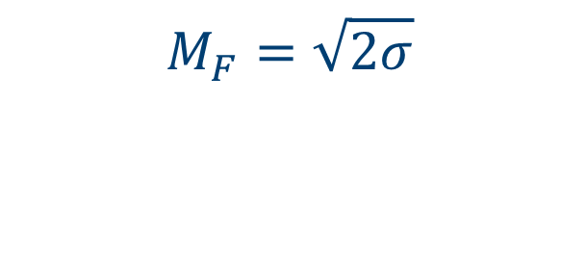
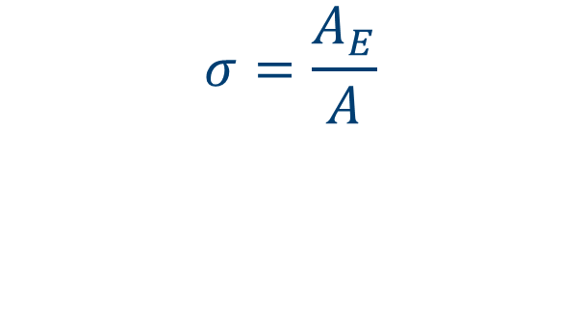
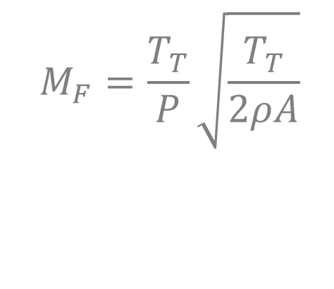

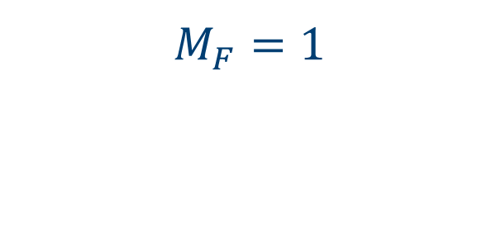

Devising a Suitable Performance Metric
$$M_{F}=\frac{T_{T}}{P}\sqrt{\frac{T_{T}}{2ρA}}$$
$$A$$
$$A_{E}$$
$$M_{F}=\sqrt{2σ}$$
$$A_{E}= ?$$
$$σ=\frac{A_{E}}{A}$$
$$M_{F}=1$$
Notes:
Pereira/CV analysis
Greater diffusion, less KE loss – limit due to adv P causing BL separation, not as much pressure recovery, effective sigma less
No control on jet area
Full control on jet area with EDF, up to a limit

Slide 4
Project Aims
Ducted Fan design for hover
Characterising Ducted Fan
Develop flying testbed
Stability
In-flight measurements

Slide 5
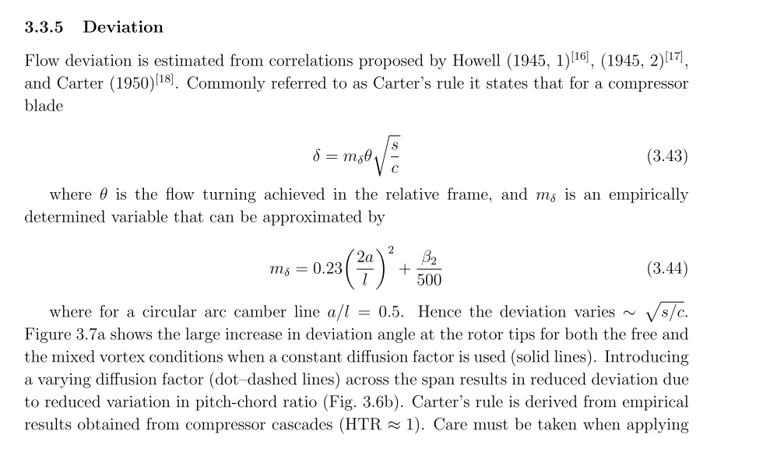
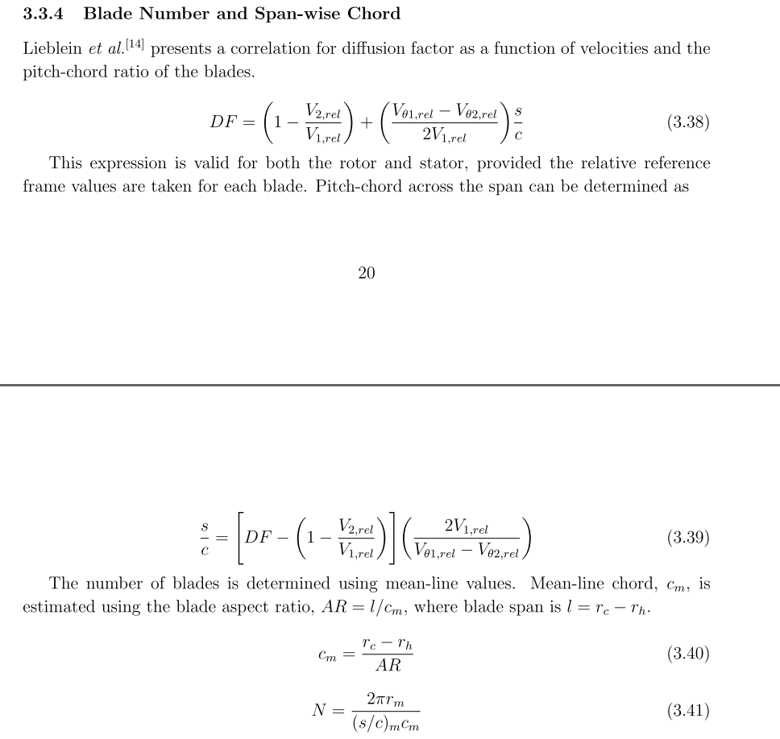
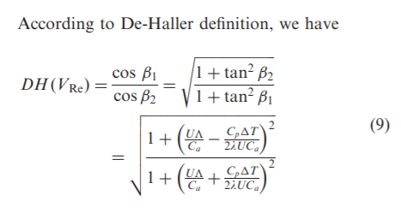

Slide 6
Design Methods
Assumptions
Isentropic flow
No inlet/exit swirl
1D design
SFME, SFEE
2D design
Radial equilibrium
Mixed vortex
Sweep & lean
Design Process
Axial velocity
Blade speed
Velocities
Flow angles
Chord distribution
Blade angles
Number of blades
Notes:
1d design – rms value
Thought process
Mixed vortex .5 – will give more uniform chord as seen later

Slide 7
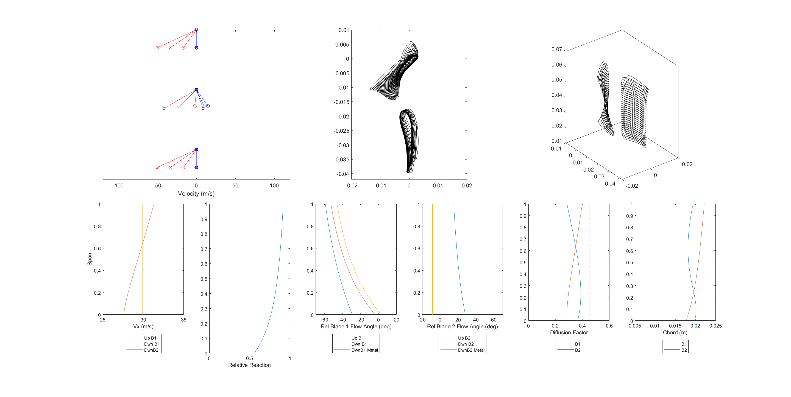
Generating Blade Profiles
Relative Velocities
Absolute Velocities
Vx
(Rotor Plane)
Inputs
Φ, σ, Thrust, Geometry
(Stator Plane)

Slide 8
Design Methods
Assumptions
Isentropic flow
No inlet/exit swirl
1D design
SFME, SFEE
2D design
Radial equilibrium
Mixed vortex
Sweep & lean
Design Process
Inputs
Φ, σ, Thrust, Geometry
Axial velocity
Blade speed
Velocities
Flow angles
Chord distribution
Blade angles
Number of blades
Notes:
1d design – rms value
Thought process
Mixed vortex .5 – will give more uniform chord as seen later

Slide 9
Generating Blade Profiles
Vx
(Rotor Plane)
Relative Velocities
Absolute Velocities
(Stator Plane)

Slide 10
Generating Blade Profiles
Use Lieblein correlation to set midspan chord
Use Carter’s empirical relation to set blade angles
Notes:
Midline as basis!!
Midspan chord set by Lieblein DF
Midspan blade metal angles by Carter’s empirical relation from compressor cascade tests
Constant deviation across span sets rest of angles

Slide 11
Generating Blade Profiles
Carter’s relation recalculates chord distribution
Lieblein correlation recalculates diffusion factor
Notes:
Chord recalculated based on constant deviation (Carter’s rule)
Diffusion Factor recalculated across span according to Lieblein’s correlation

Slide 12
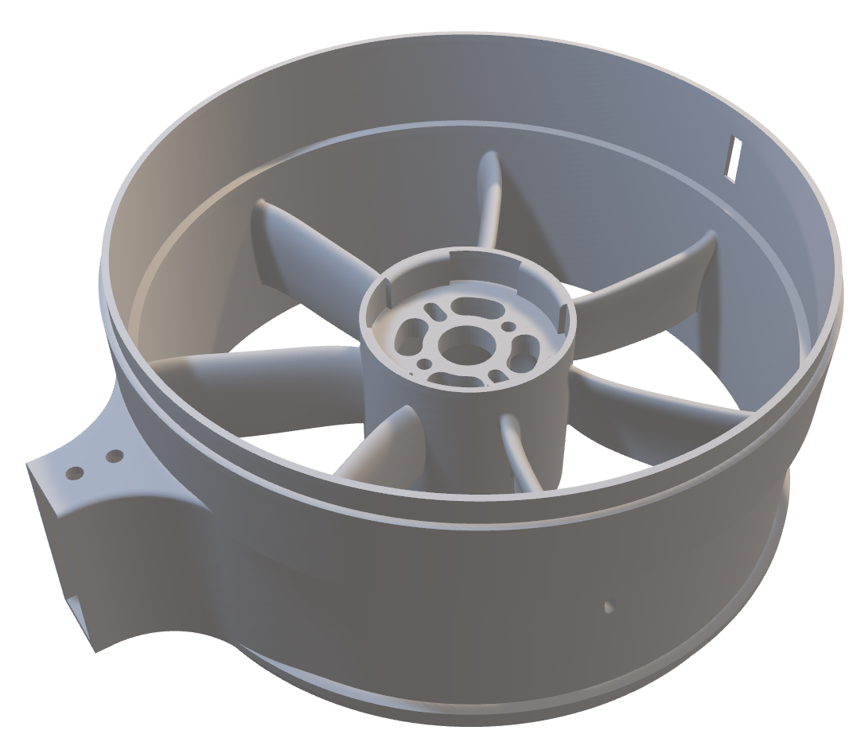
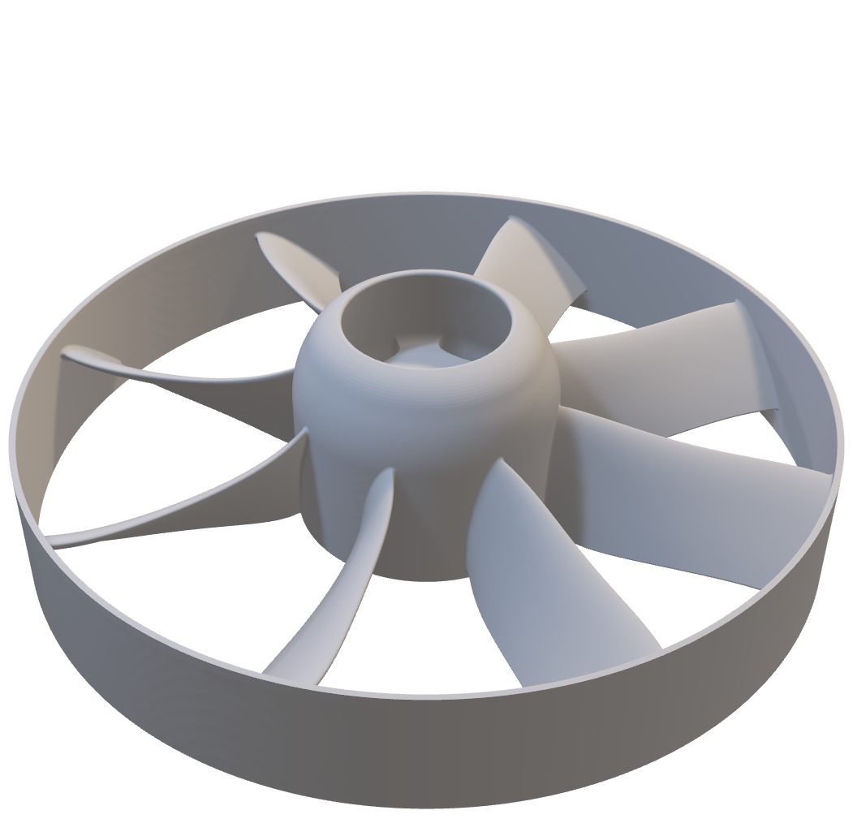
Chosen Design
Sweep & Lean
Adding sweep and lean minimizes end-wall losses
Notes:
Rotor-stator, long intake and moderate diffuser
Stator takes out swirl
Printing!!!!
Static tests, ch’ic perf
Reduce corner sep and trailing edge los

Slide 13
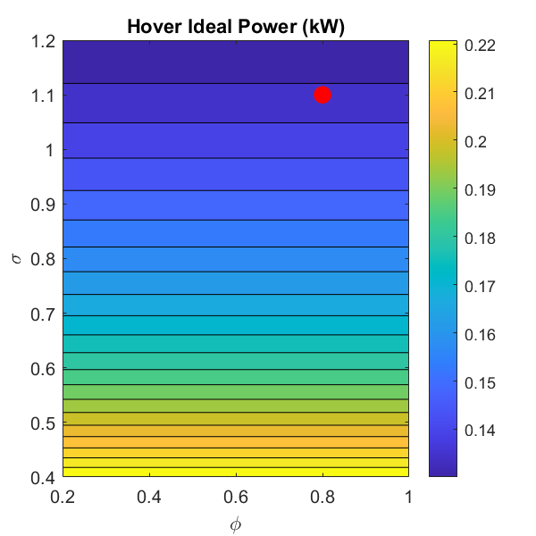
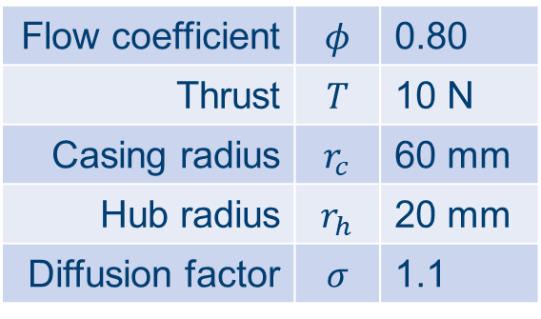
Chosen Design
Flow coefficient | $$φ$$ | 0.80
Thrust | $$T$$ | 10 N
Casing radius | $$r_{c}$$ | 60 mm
Hub radius | $$r_{h}$$ | 20 mm
Diffusion factor | $$σ$$ | 1.1
De Haller number = 0.85 Stall limit = 0.72
Notes:
High phi means lower RPM

Slide 14
Measuring Thrust, RPM, Pressure, Power
Pic of thing
Notes:
Overview of interfacing with

Slide 15
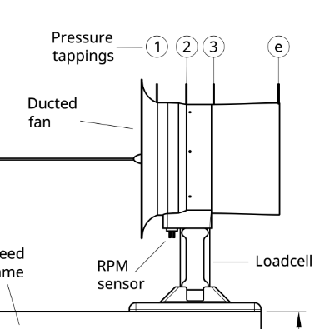
Thrust Measurement
Data Collection
Raspberry Pi
SSH over WiFi
Thrust
Shear Loadcell
Notes:
Loadcell calibration
Secure shell

Slide 16
RPM Measurement
Data Collection
Raspberry Pi
SSH over WiFi
RPM
RPM Sensor
Notes:
Secure shell

Slide 17
Pressure Measurement
Data Collection
DSA Pressure Transducer
Ethernet
DSA
Notes:
From this, coupled with RPM, can work out phi and psi

Slide 18
Power Measurement
Data Collection
QGroundControl
Telemetry
Power
Notes:
Same computer terminal

Slide 19
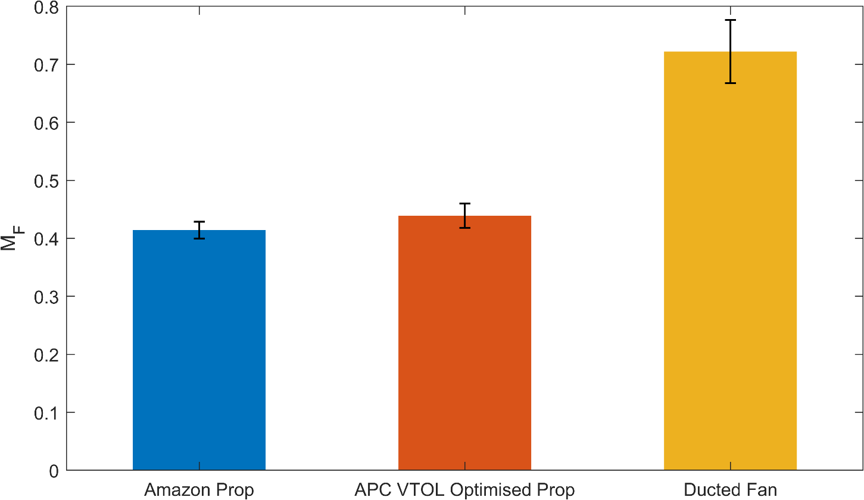
Validating Ducted Fans against Propellors
Ducted fan yields 64% increase in Figure of Merit
Notes:
Not accounting for system efficiency

Slide 20
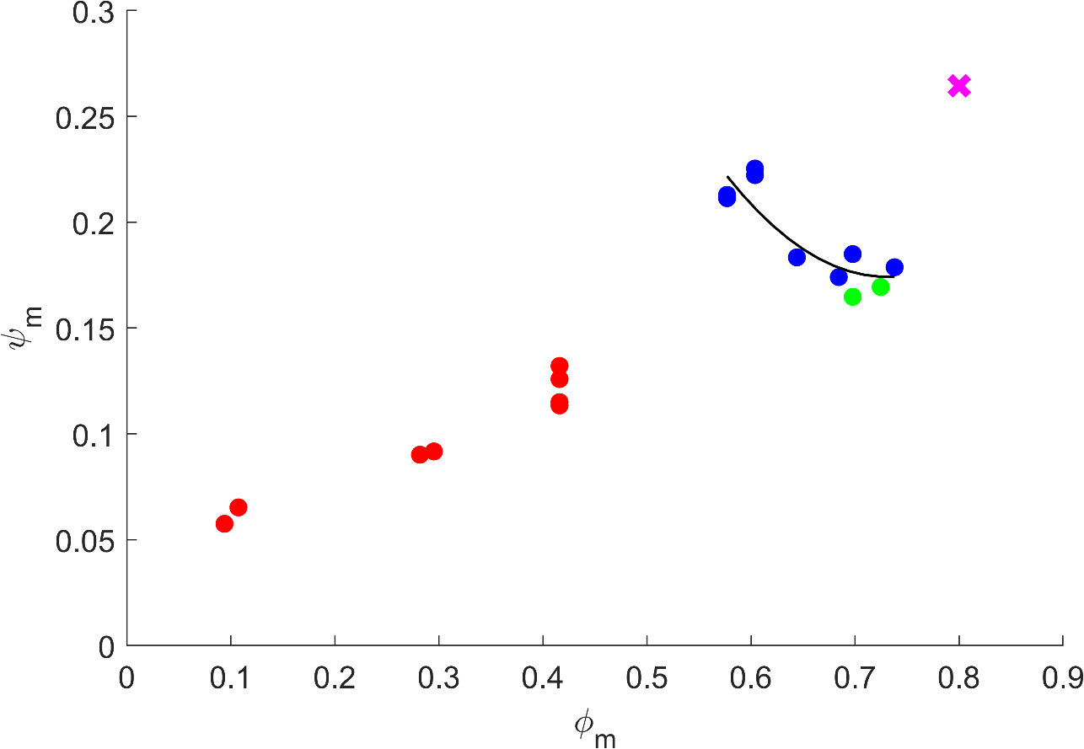
Obtaining Ducted Fan Characteristic by Varying σ
Needs recollecting
Notes:
Stall
Temperature sensitivity
Mention diffusion ducts
Includes spanwise variation due to vortex exponent
Once this is obtained, can obtain OP from flight through knowing RPM, technically SFME gives Vx for hover

Slide 21
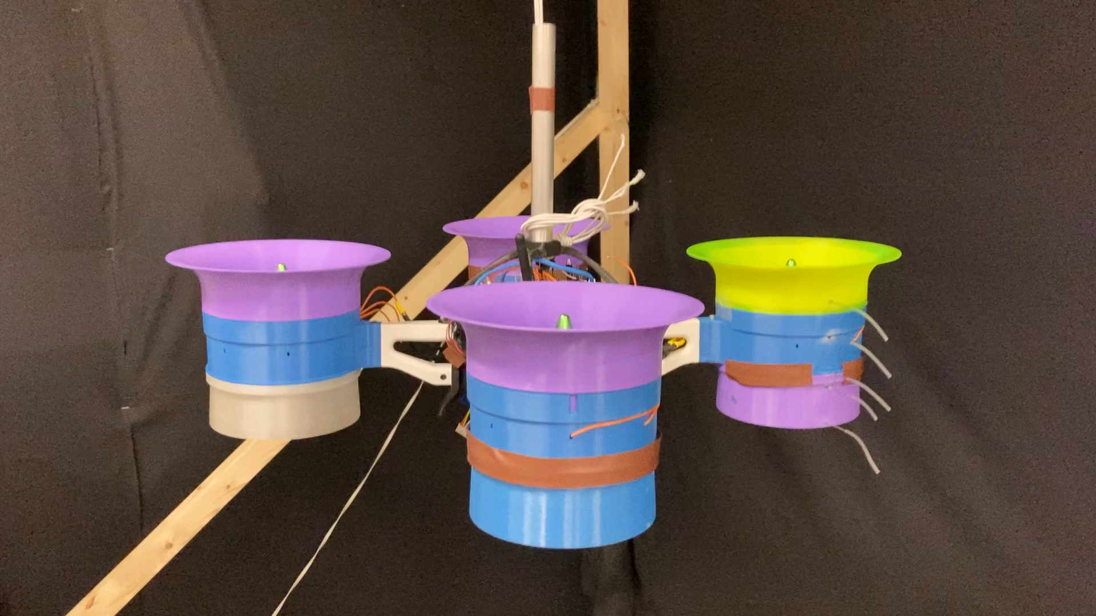
Inaugural Whittle Lab Test Flight!!
Notes:
Needs renaming

Slide 22
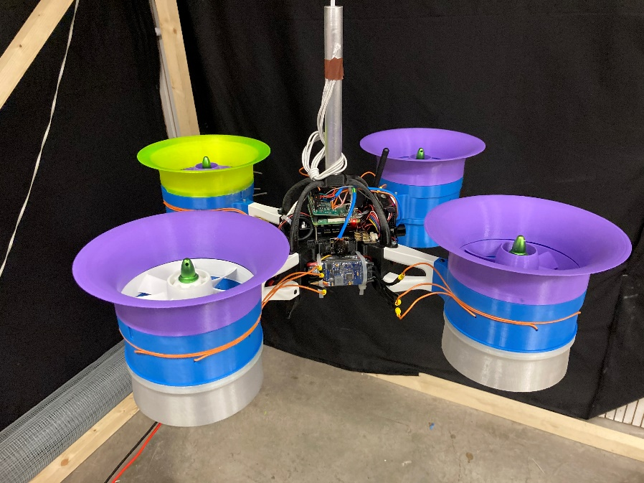
Now we have flying
Capacity to remotely measure:
Power
RPM
Pressures
Stability

Slide 23
Conclusions
So far:
Designed and manufactured 4x EDFs
Proved a 64% increase in FOM for Ducted Fans compared to propellors
Obtained a characteristic for the Ducted Fan
Developed a flying testbed
Going forward:
Ready to improve testbed and use next term
Develop existing EDF design according to work by Jonathan Collins

Slide 25
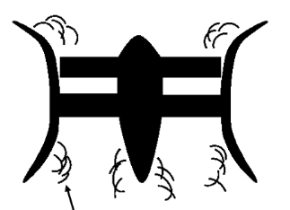
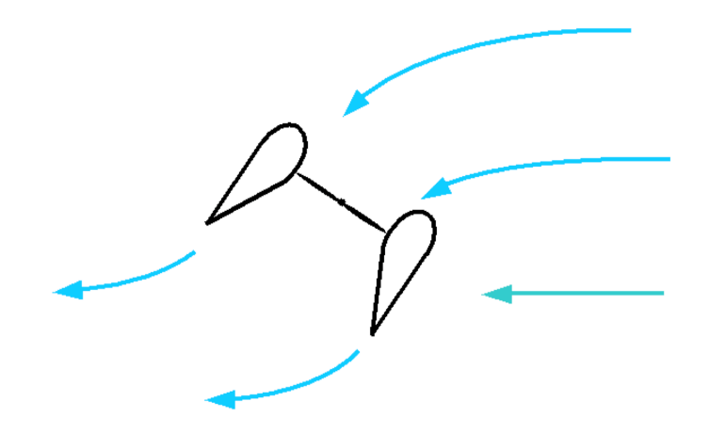

Backup slides
Inlet separation
Lining up stability with aero perf
$$M$$

Slide 26
Slides + notes
What is my project – quad vs prop, ‘is better’
FOM – quantify, hover perf etc
Project aims – flying testbed, controllability, characterise
Assumptions/Methods – zero swirl, also incl 1D CV, FOM contour, de Haller number
Design build-up – flow, need carter to get blade chord, need diffusion fac to get blah blah
Pictures of design – variables, arrows to lean/sweep
Setup
FOM
Chic
Video
Conc
Backup
If it’s not on the slide, ur not allowed to mention it
Have an ending message at the bottom of each slide

Slide 27
Structure
Intro and motivations (2-3 mins)
Present setup, method (1-2 mins)
Mention FOM
Display results (2 mins)
FOM comparison (ND) with props and edf at different rpms
Ch’ic of EDF
Play video and discuss (1 min)
Conclude and present next steps (2 mins)

Slide 28
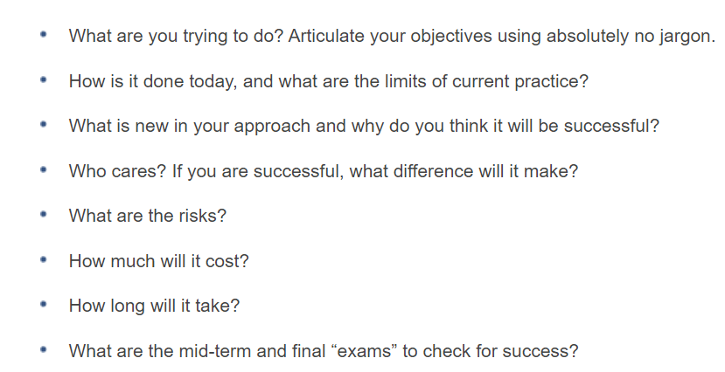
What, How, Why
Currently propellors, but EDFs have multiple performance benefits
Design and build a VTOL EV with ducted fans for propulsors
Have a flying testbed to simulate various test cases – ref 5 stage flight
Can also assess trade-offs between number of propulsors and size
Fan can be characterised, so operating point can be easily obtained

Slide 29
What have I done this term
Familiarised self with existing MATLAB design code to design new propulsor - updated areas where necessary (eg adding sweep/lean, creating stator holes)
Successfully operated static rig with all interfaces working
Repaired drone chassis, designed new connecting arms, fiddled with printing too many times
Collected performance results from different designs, attempted to produce ch’ic by varying sigma (WORK TO DO HERE)
Confirmed FOM improvement from prop to EDF
Adapted design to accommodate new motors
Built up drone to fly with 4x EDF’s

Slide 30
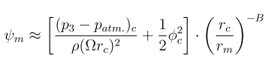
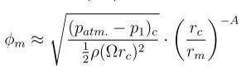
Vortex Exponent
SDG: 1 = free, -1 = forced

Slide 31
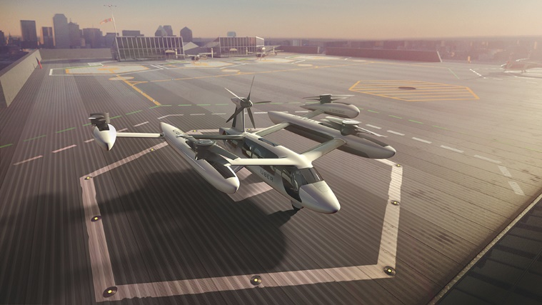
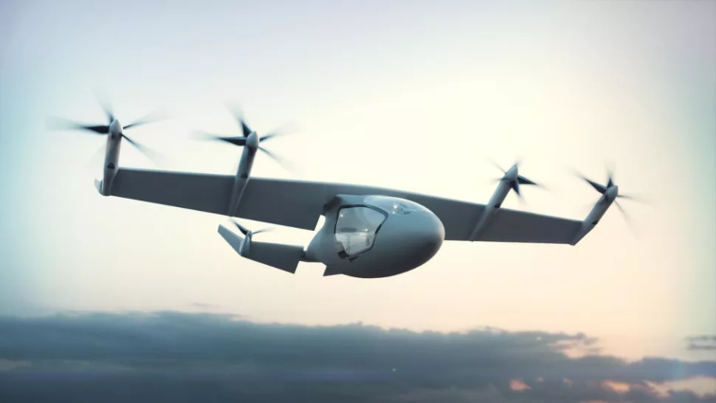
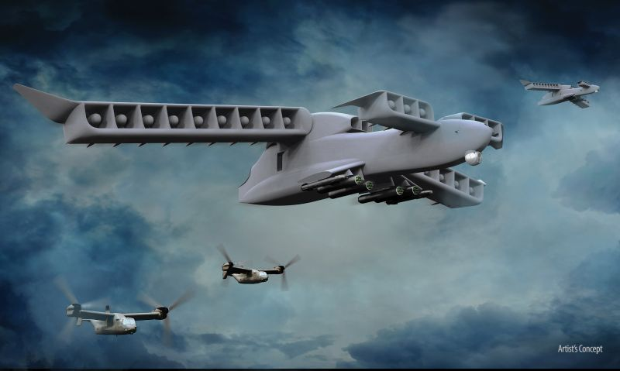
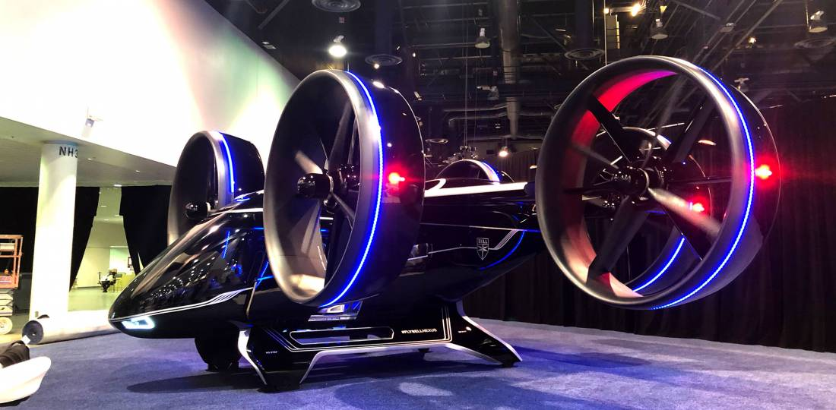
The Take-Off of e-VTOL
Ducted Fans
Higher thrust
Less Noise
Contained (Safer)
Do they work at a SYSTEM level?
BUT
Notes:
The e-VTOL market has exploded in the past few years and is projected to continue growing, trebling by 2024.
The market shows us that no one configuration is being sought after, with a vast array of designs put forward
PRIMARILY
PROPELLERS
DUCTED FANS
Ina static test, a ducted fan has a higher thrust output, is less noisy and is contained, meaning it is safer.
However does the cost of weight and stability prevent them from being a better propulsion system?
How we can determine whether ducted fans are a viable system solution to the e-VTOL propulsion problem>

Slide 32
Project Questions
Are ducted fans more efficient in static hover?
Are ducted fans dynamically stable in an e-VTOL application?
Notes:
This problem has two primary facets, arising from
A static analysis
A dynamic analysis
Firstly, the ducted fan as a system must be more efficient than a standard propeller in a static hovering configuration. Does the reduction in power requirement outweigh the increase in weight of the vehicle? Hence, ‘Are they a more efficient SYSTEM for e-VTOL vehicles?’
Secondly, the dynamic feasibility of the ducted fan is to be considered. How does the performance vary when the vehicle is subjected to lateral manoeuvres? Hence, ‘Are ducted fans FEASIBLE for an e-VTOL APPLICATION?’

Slide 33
Are ducted fans more efficient in static hover?
Does added efficiency outweigh weight penalty for a simple light-weight design?
Hover tests with variable payload
Quadcopter propulsors compared:
Generic off-the-shelf propeller
APC e-VTOL optimised propeller
Ducted Fan (??)
Notes:
Changing a propulsor from a propeller to a ducted fan introduces a significant increase in weight.
The design must therefore be weight minimized, however, does the increase in performance outweigh the extra weight required?
Tests will be conducted with various payloads to determine performance across the fan characteristic.
Need to design a ducted fan suitable for this test.

Slide 34
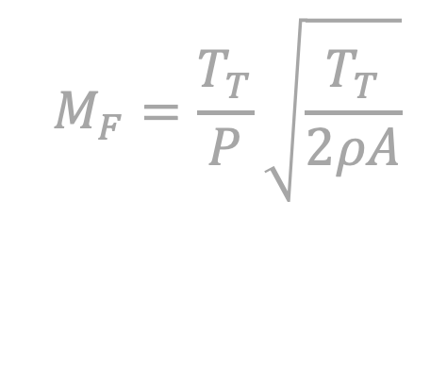
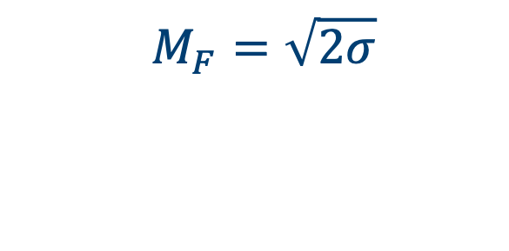




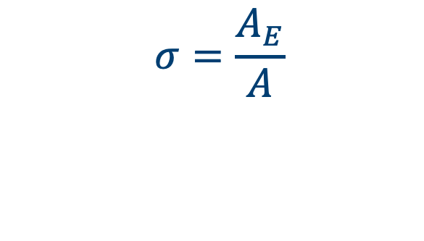
A Superior Figure of Merit
$$M_{F}=\frac{T_{T}}{P}\sqrt{\frac{T_{T}}{2ρA}}$$
$$A$$
$$A$$
$$A_{E}$$
$$M_{F}=1$$
$$M_{F}=\sqrt{2σ}$$
$$σ=\frac{A_{E}}{A}$$
Notes:
Need to quantify performance, SOMETHING TO MAXIMISE
Figure of Merit is a non-dimensional thrust to power ratio for a propulsor with zero freestream velocity, ie HOVER.
An ideal ducted fan can be shown to have a larger figure of merit than an open-rotor propeller, but this comes at the price of weight.
The diagram shows that an ideal propeller has a maximum FoM of 1. This is an absolute limit.
However, the ducted fan has another degree of freedom, the exit area of the diffuser can be varied and set (shown here as A_E). This control over flow area results in a FoM that has a dependence on the diffusion factor (SIGMA, defined here by A_E/A). This means an ideal ducted fan with a 1:1 diffuser has a FoM of 1.4, even without any diffusion.
Hence, how can the ducted fan be designed to maximise FoM in a system with a diffusion factor limited by both length and weight?
EXTRA
PROPELLER MODEL
Velocity actuator
Exit area NOT EQUAL to prop area (ie SMALL but non-unity FPR)
EXIT pressure equal to atmospheric
Consider ENERGY and MOMENTUM to get expression for area ratio

Slide 35
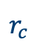






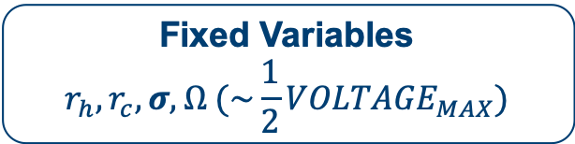

Reduction of Free Variables
Floating Variables
$$Φ, ψ$$
Fixed Variables
$$r_{h}, r_{c}, σ, Ω (\sim \frac{1}{2}{VOLTAGE}_{MAX})$$
$$Ω$$
$$T_{P}$$
$$σ^{2}=\frac{φ^{2}}{2ψ}$$
$$W_{P}$$
$$r_{h}$$
$$r_{c}$$
$$A_{E}$$
Notes:
The ducted fan has a broad design space that can be characterized by two variables, flow coefficient and stage loading (PHI and PSI)
The remaining variables have been fixed, either inherently by definition (sigma phi psi)
OR by geometric constraints (r_h)
OR by electrical limits (OMEGA)
However, there is no direct limit on the casing radius?
To close the problem, the thrust produced must be equal to the vehicle weight. I developed a mass model to relate both these quantities to the casing radius, and solving this problem at each design point, obtained the critical operating point for each.

Slide 36


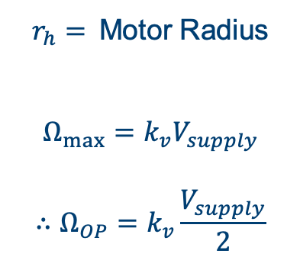
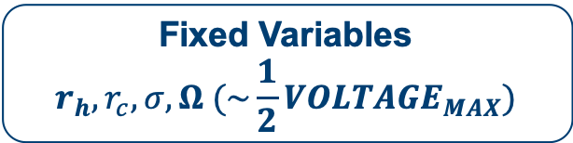

Reduction of Free Variables
Floating Variables
$$Φ, ψ$$
Fixed Variables
$$r_{h}, r_{c}, σ, Ω (\sim \frac{1}{2}{VOLTAGE}_{MAX})$$
$$Ω$$
$r_{h}=$Motor Radius
$$Ω_{max}=k_{v}V_{supply}$$
$$∴Ω_{OP}=k_{v}\frac{V_{supply}}{2}$$
$$T_{P}$$
$$W_{P}$$
$$r_{h}$$
$$r_{c}$$
Notes:
The ducted fan design has a broad design space that can be characterized by two variables, flow coefficient and stage loading (PHI and PSI)
The remaining variables have been fixed, either inherently by definition (sigma phi psi)
OR by geometric constraints (r_h)
OR by electrical limits (OMEGA)
However, there is no direct limit on the casing radius?
To close the problem, the thrust produced must be equal to the vehicle weight. I developed a mass model to relate both these quantities to the casing radius, and solving this problem at each design point, obtained the critical operating point for each.

Slide 37



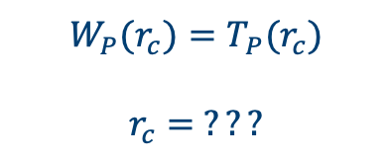
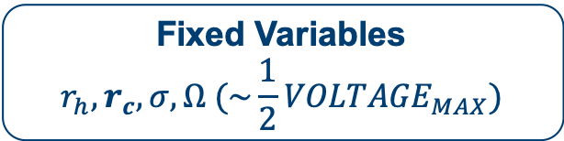
Reduction of Free Variables
Floating Variables
$$Φ, ψ$$
Fixed Variables
$$r_{h}, r_{c}, σ, Ω (\sim \frac{1}{2}{VOLTAGE}_{MAX})$$
$$Ω$$
$$T_{P}$$
$$W_{P}(r_{c})=T_{P}(r_{c})$$
$$r_{c}= ???$$
$$W_{P}$$
$$r_{h}$$
$$r_{c}$$
Notes:
The ducted fan design has a broad design space that can be characterized by two variables, flow coefficient and stage loading (PHI and PSI)
The remaining variables have been fixed, either inherently by definition (sigma phi psi)
OR by geometric constraints (r_h)
OR by electrical limits (OMEGA)
However, there is no direct limit on the casing radius?
To close the problem, the thrust produced must be equal to the vehicle weight.
I developed a mass model to relate both these quantities to the casing radius. Solving this problem at each design point obtains the critical operating r_c for design.

Slide 38
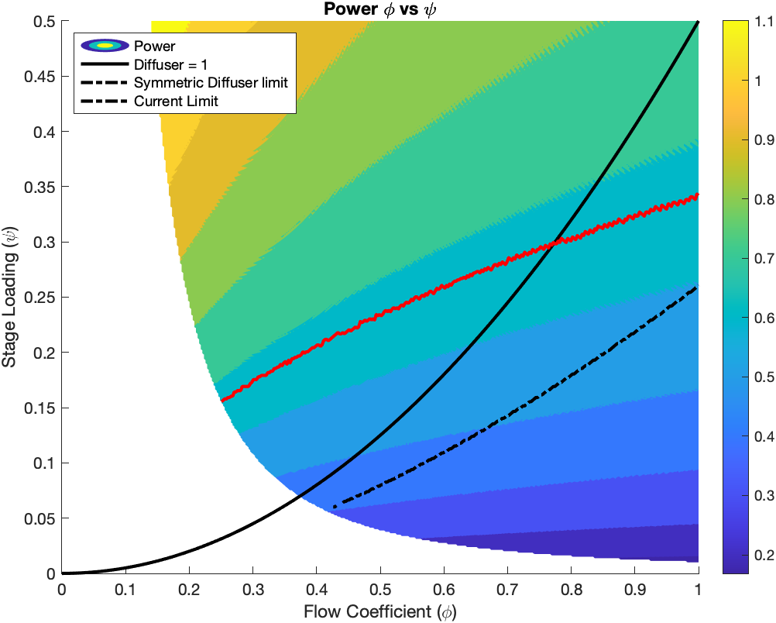

Maximise Figure of Merit, Minimise Power
Increasing $M_{F}$
Notes:
I developed this model to maximise FoM and Minimise power.
The diagram shows the power required at each design point.
There are limits shown.
The red line is a cuirrent limit for the motor
The Solid black line is the limit of diffusion factor =1
The dashed balck line is a geometric limit of diffusor symmetry.
This suggest we push the design towards the bottom left to reduce power.

Slide 39
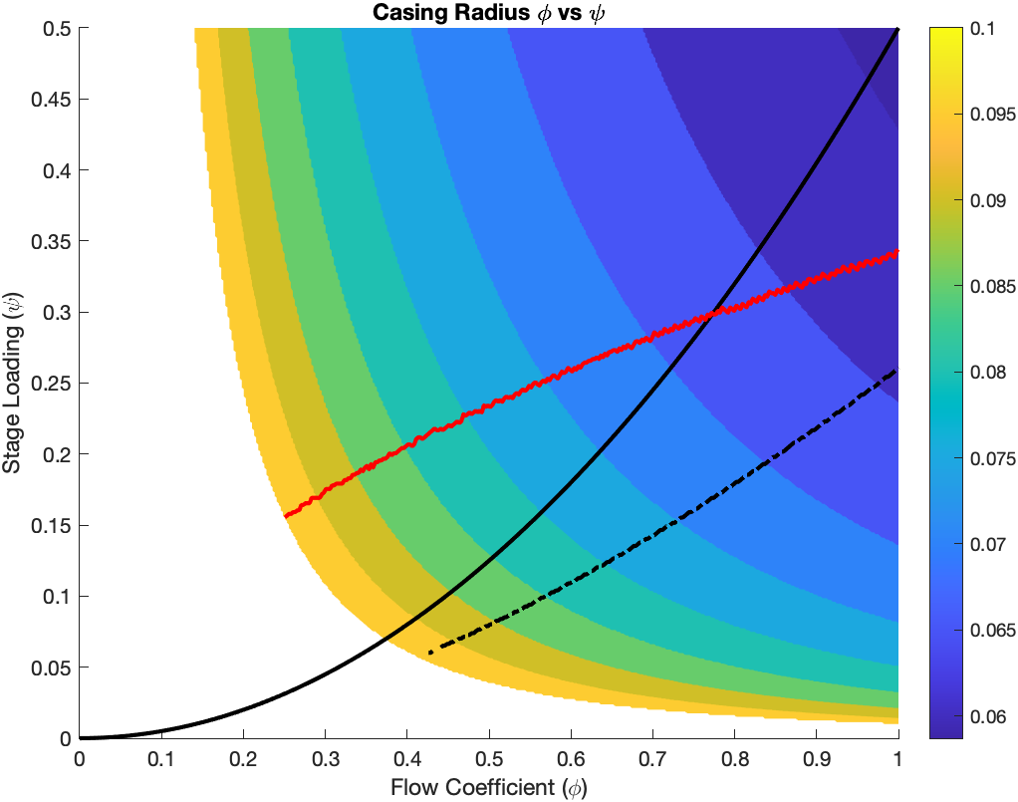
Minimise Power… What a big fan you have
Notes:
This slide shows the variation in casing radius across the design space.
Previously, we determined the bottom left is the ideal design region however, this shows those designs to be too large.
Therefore I have chosen a design in the middle of this region

Slide 40
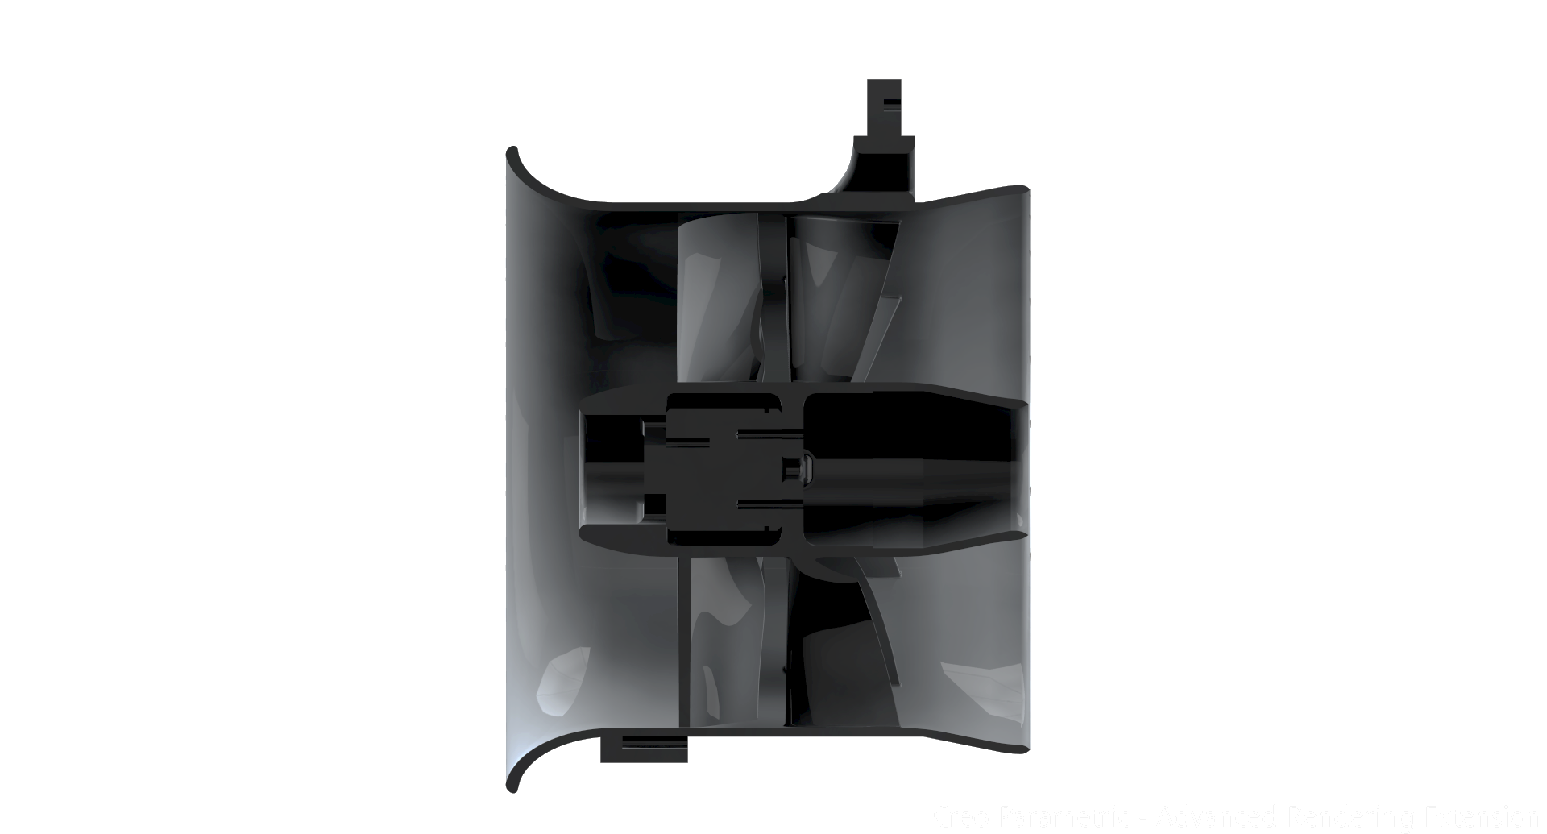
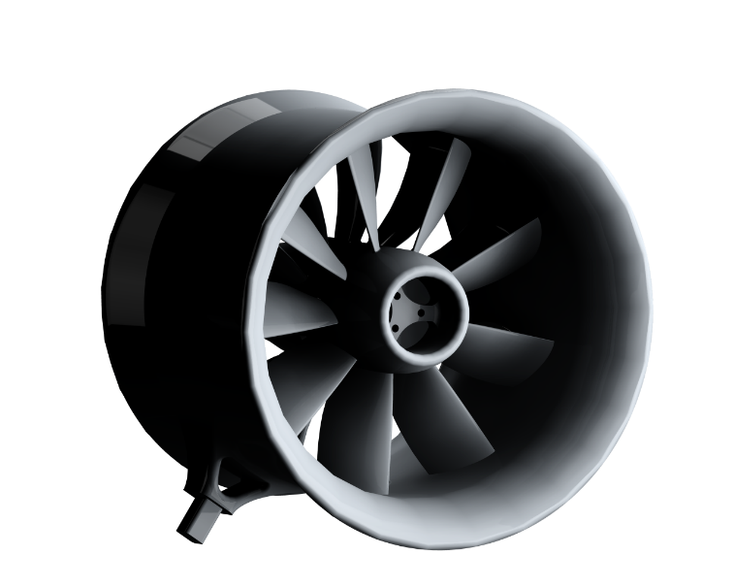
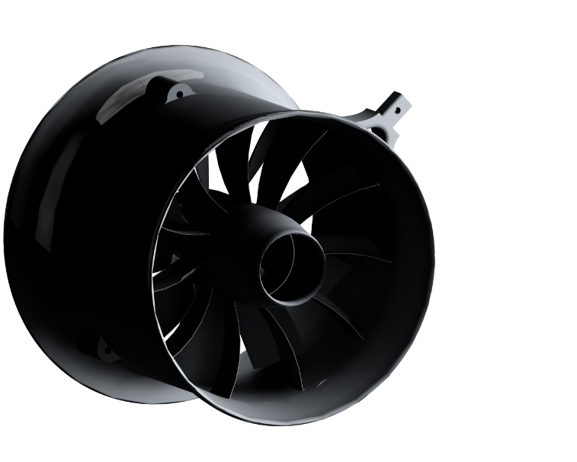
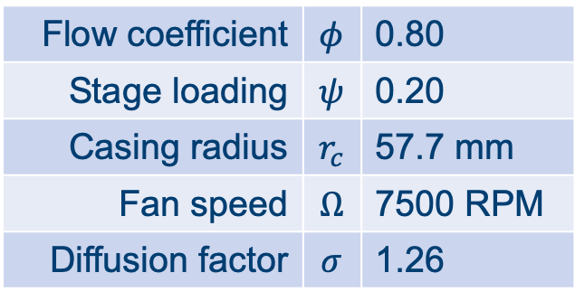
Chosen Design
Flow coefficient | $$φ$$ | 0.80
Stage loading | $$ψ$$ | 0.20
Casing radius | $$r_{c}$$ | 57.7 mm
Fan speed | $$Ω$$ | 7500 RPM
Diffusion factor | $$σ$$ | 1.26
Notes:
From my model, I have chosen this design.
A conservative diffuser and intake is used, that will be improved by the work Megan is going to talk about.

Slide 41
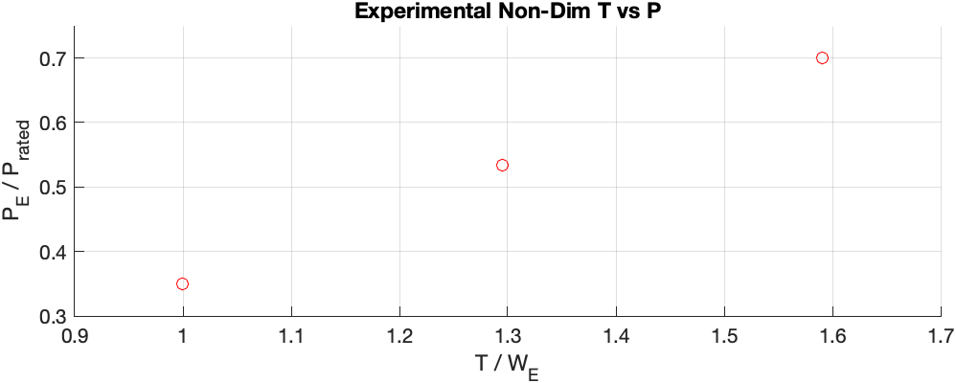
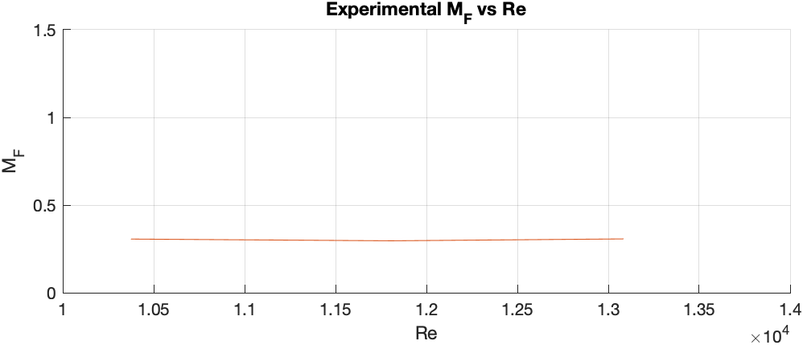

Preliminary Propeller Data – The Baseline
Power vs Thrust
Constant $M_{F}$ wrt $Re$
Notes:
The fan performnce will be compared against propeeller performance.
I have so far collected data for the propeller, shown here.
This shows teh propeller to have a constant FoM at various loads as expected. This FoM is fairly low as it is for an unoptimised propeller
I expect to see the hover optimized propeller closer to but still below 1, and the fan to be somewhere between 1 and 1.5
I will now talk about the dynamic aspect of the test.

Slide 42


Are ducted fans FEASIBLE in an e-VTOL application?
Does the intake duct reduce dynamic stability during manoeuvres?
Small horizontal manoeuvres of varying amplitude
Dynamic stability determined:
Does separation occur at intake?
Does control system remain stable?
$$M$$
Vehicle Velocity
Notes:
Now the fan has been developed, the next question is that of dynamic performance,?
The primary concern here is how the fan behaves in a crosswind, a common flow feature for a vehicle transitioning from hover to horizontal flight. (AS IN THE DIAGRAM)
Crosswinds can lead to separation and resulting decrease in performance AS WELL as destabilising moments on the vehicle.
THEREFORE the key questions are
Does separation occur?
Does the vehicle remain stable?
A test bed is needed to determine this

Slide 43
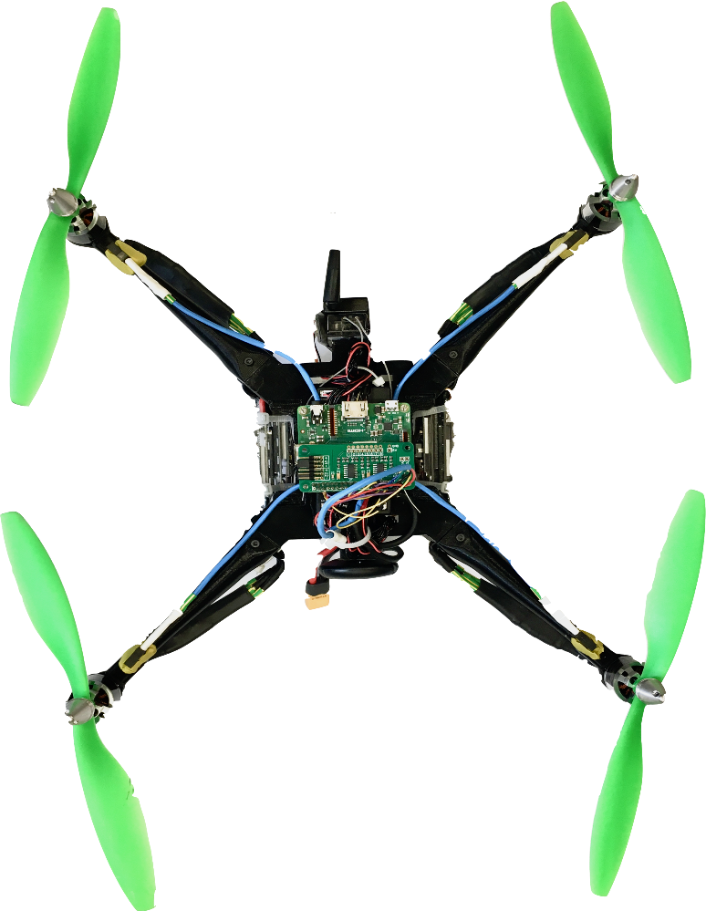
Modular Dynamic Test Bed
Work completed as part of UROP
Light-weight 3D printed parts (PLA)
Modular
Pixhawk4 flight hardware
Bespoke chassis
Additional Michaelmas work
RaspberryPi based on-board, real-time sensor hub
Sensor design, development and integration
Detachable Propulsor Assembly
(Ducted Fan or Prop)
Data Logging and Flight Control
Notes:
Here we see this test bed,
It has a cocentral data logging and flight control chassis,
as well as modular limbs and propulsor assemblies that are suitable for both ducted fans as well as propellers.
My design was 3D printed at the Whittle, allowing for rapid prototyping, also allowing the design to be as light as possible in my price-range (no carbon yet, sadly).
I have integrated flight control systems with a custom sensor management unit to provide on-board data logging and autonomous flight control.
This test bed allows all the required metrics to be determined…

Slide 44
Data Collection, Control and Conclusions
Figure of Merit
Power (Electrical, RPM, calibration)
Thrust
Flow separation at intake
Pressure Transducers
Control system stability
6-DoF inertial sensors
3 position sensors
Laptop
Pixhawk4 Flight Controller
Power Module (PM07)
RPi3 A+ Sensor Management
ONBOARD
ESC
ADC Breakout
RPM Sensors
Ultrasound Proximity Sensors
Pressure Transducers
Motor Assembly
Notes:
An overview of the system
Two main aspects to testing this way. The first is Control and the second is Data Collection.
This graphic shows the system level interactions involved.
Managing the vehicle as a whole is a laptop
The control aspect is handled by a Pixhawk4 Flight Controller that manages the stability of the platform.
Power and Motor control is shown on the LHS
The RHS shows the sensors and the RPi sensor hub.
I have developed a Raspberry Pi based sensor management unit that can record and transmit data. It includes up to 8-channel ADC that allows multi-stream data-logging remotely or on-board.
Sensors are integrated with the existing flight software to enable autonomous position control.
They allow both static and dynamic performance to be determined. These are shown on the left.
Figure of Merit is determined from Power and Thrust measurements
Flow separation comes from tappings and pressure transduces at the intake
Control stability can be determined from the flight control system
Using this test platform, I will be able to determine the performance of the fan in both a static AND dynamic context NExt term .
THANK YOU

Slide 45
Notes:
Back up slides
ESDU
LOW RE PROFILES FROM MATHEW M PAPER (DYSON)

Slide 46
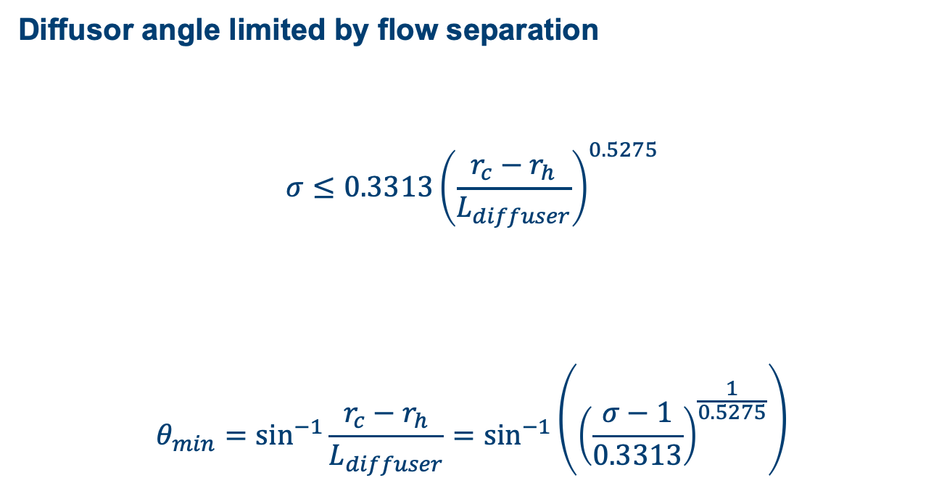
Mass Model
Diffusor angle limited by flow separation
$$σ≤0.3313{\left(\frac{r_{c}−r_{h}}{L_{diffuser}}\right)}^{0.5275}$$
$$θ_{min}=\sin^{−1}{\frac{r_{c}−r_{h}}{L_{diffuser}}}=\sin^{−1}\left({\left(\frac{σ−1}{0.3313}\right)}^{\frac{1}{0.5275}}\right)$$
Notes:
When considering the mass model, a hidden fixed geometric variable, diffuser length, is set by the maximum angle of the diffuser from the axial flow direction.
The constants shown here are obtain from empirically obtained data in ESDU 75026 and represent a conservative limit on diffuser separation.
The equation shows that this limit can be expressed solely in terms of SIGMA (diffusion ratio) and hence the operating point variables PHI and PSI.

